Slide 1








Motion Analysis for Rehab Exercises

Slide 2
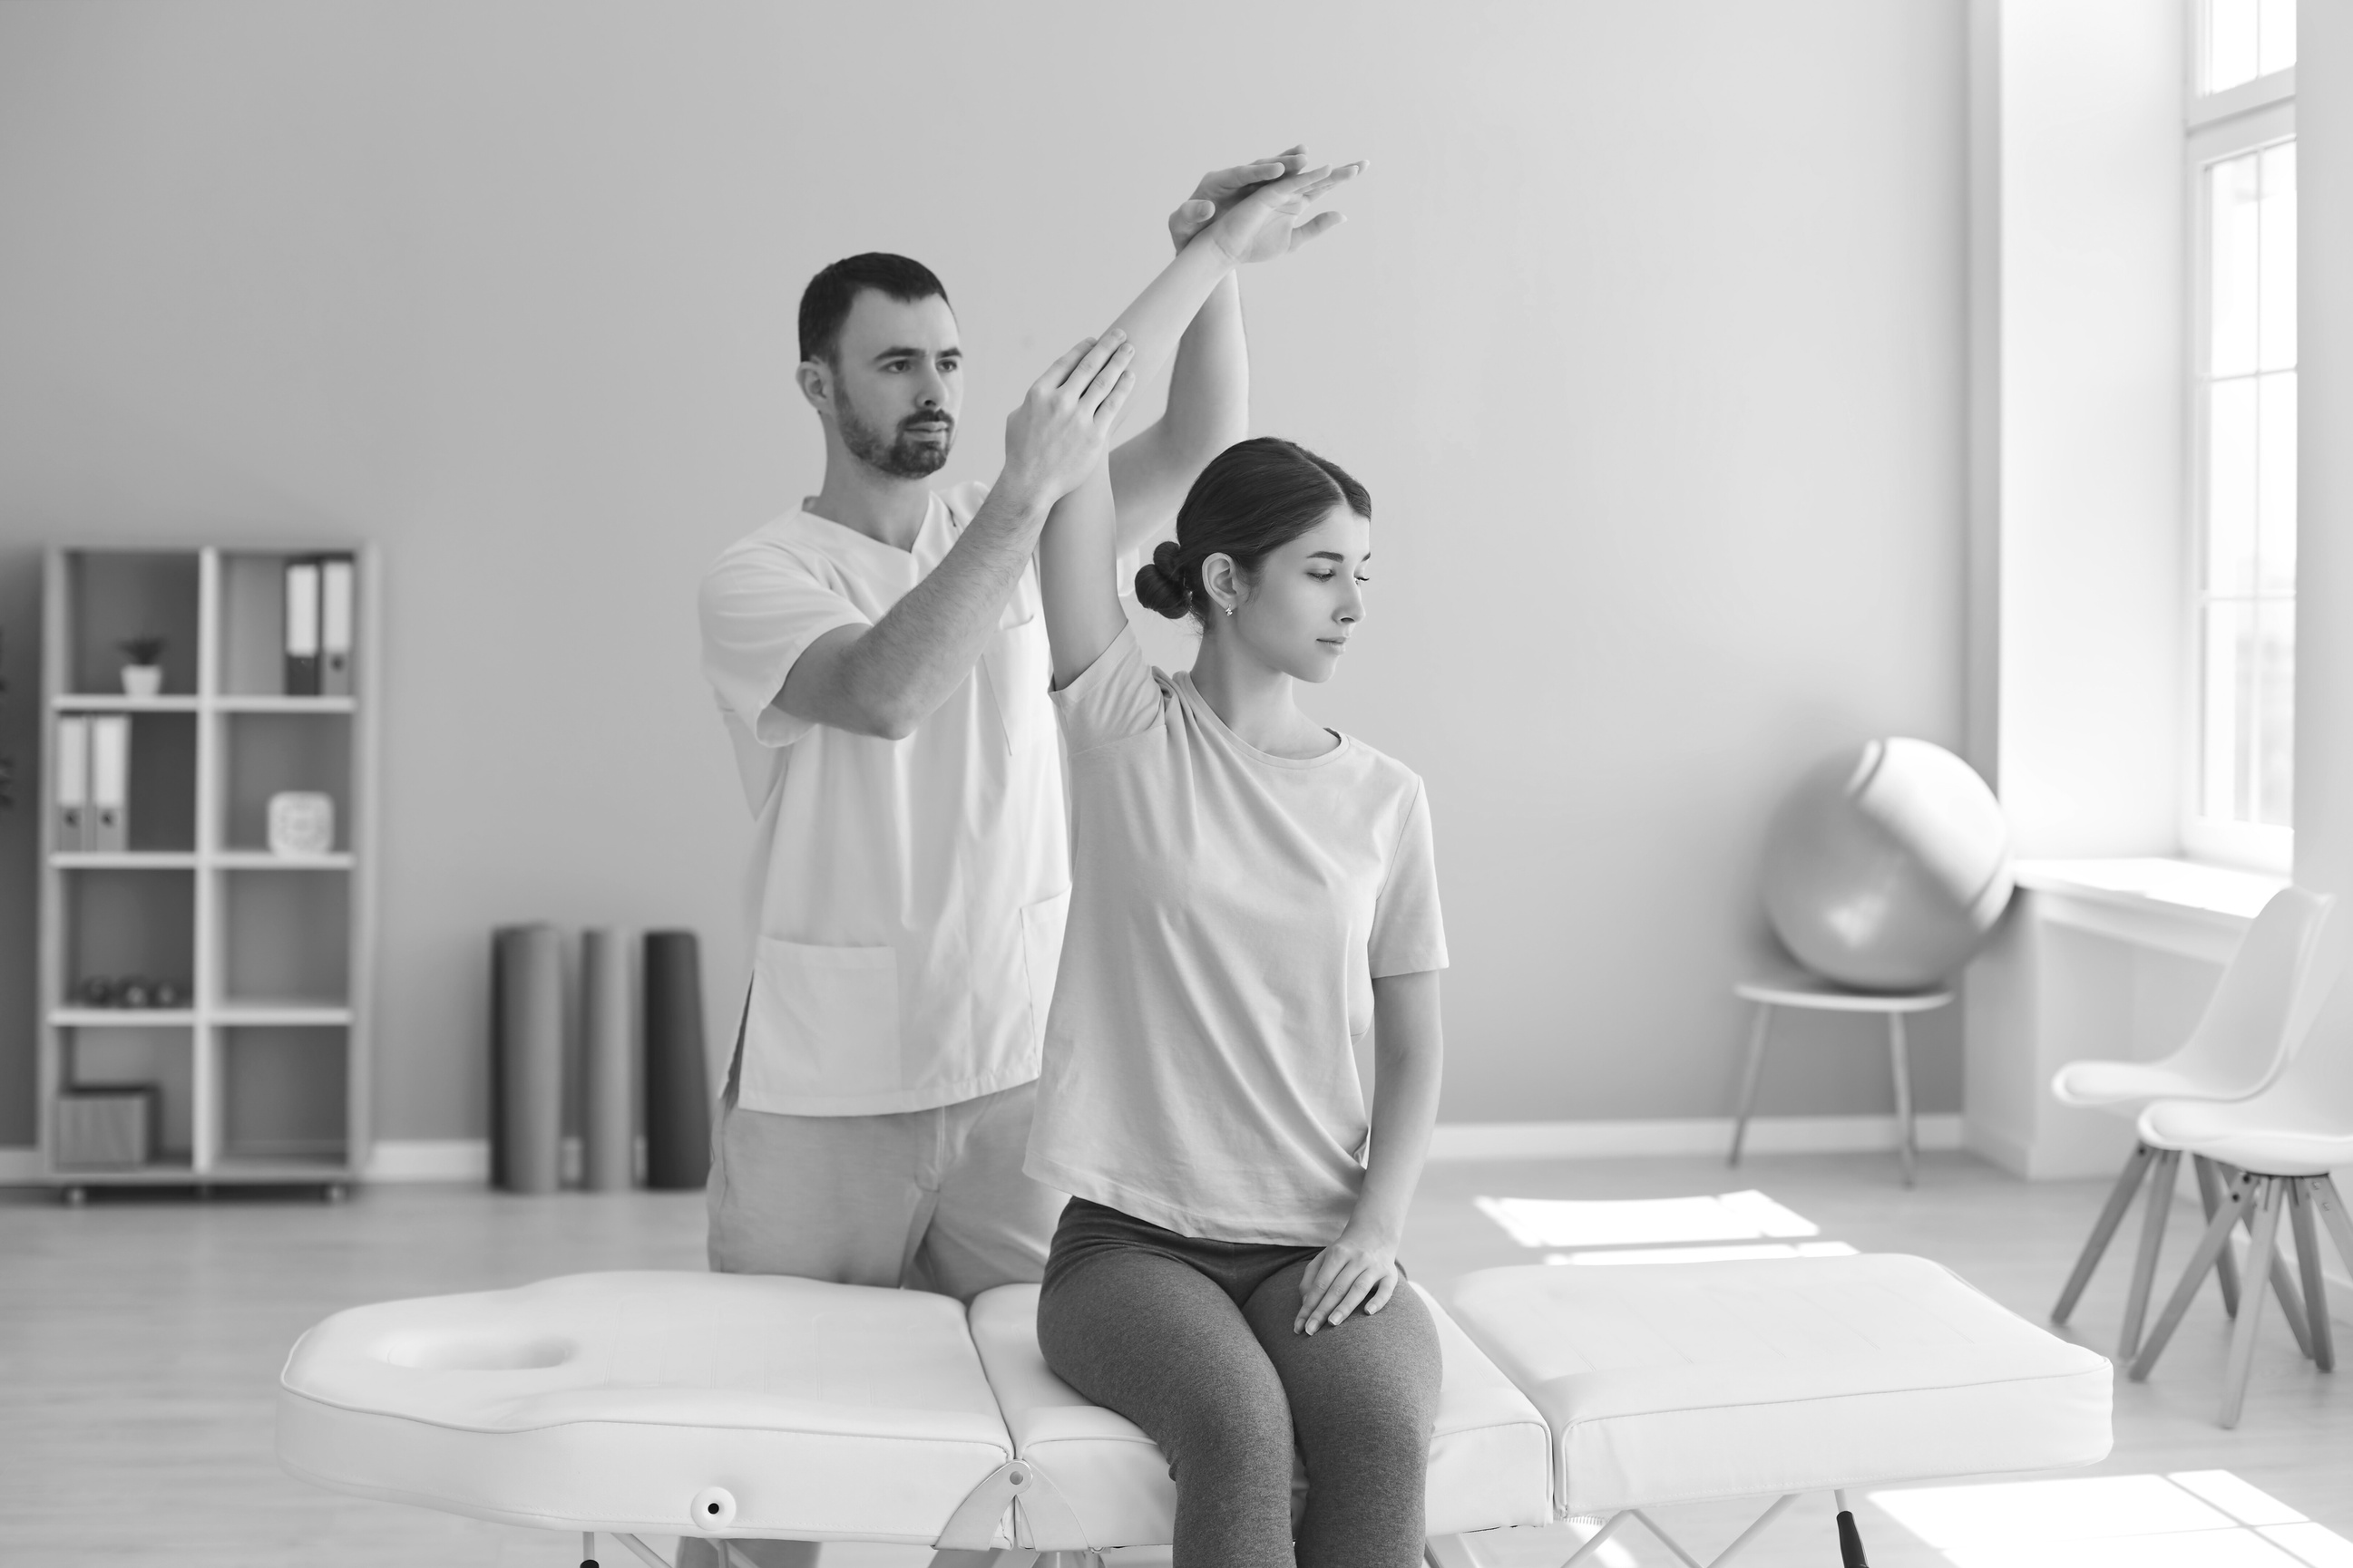
Introduction to Problem Statement
🔹 Problem Statement
Patients often perform exercises without supervision, leading to:
Incorrect movements
Slower recovery or worsening of condition
Risk of new injuries
Poor adherence to prescribed therapy reduces its effectiveness.
🔹 Expected Outcomes
Ensure accurate exercise execution
Reduce risk of injury
Improve rehabilitation efficiency and recovery outcomes

Slide 3
Liturature Survey
Recent advancements in deep learning have significantly improved motion analysis in physical therapy, enabling automated movement assessment and real-time feedback for rehabilitation exercises. Several studies have explored different approaches to enhance physiotherapy evaluation.
Munoz-Salinas et al. introduced the UCO Physical Rehabilitation dataset, which contains 2,160 videos of rehabilitation exercises. Their study highlighted that while pose estimation models perform well in upright positions, they struggle with patients lying down, indicating the need for specialized algorithms.
Vakanski et al. proposed a deep learning-based framework for evaluating rehabilitation exercises. Their system combines movement performance metrics, scoring functions, and deep spatio-temporal neural networks to assess motion quality and patient progress effectively.
Kulkarni et al. developed a physiotherapy assessment system using OpenCV and MediaPipe to extract key body points and compute joint angles. Their approach provides real-time audio feedback and tracks patient progress through visualized improvement reports, offering a cost-effective rehabilitation solution.
Wang et al. introduced VecNet with LSTM, a model designed to analyze relative positional changes and predict motion patterns. Their study demonstrated improved motion recognition and rehabilitation assessment accuracy, helping track patient recovery more effectively.
Ben-Younes et al. conducted a review of deep learning-based pose estimation techniques for movement feedback. They found that CNN-based models dominate the field but emphasized the need for improved feedback accuracy to enhance rehabilitation outcomes.
These studies highlight the role of deep learning in physiotherapy, focusing on pose estimation, movement tracking, and real-time feedback to improve rehabilitation efficiency and patient outcomes.

Slide 4
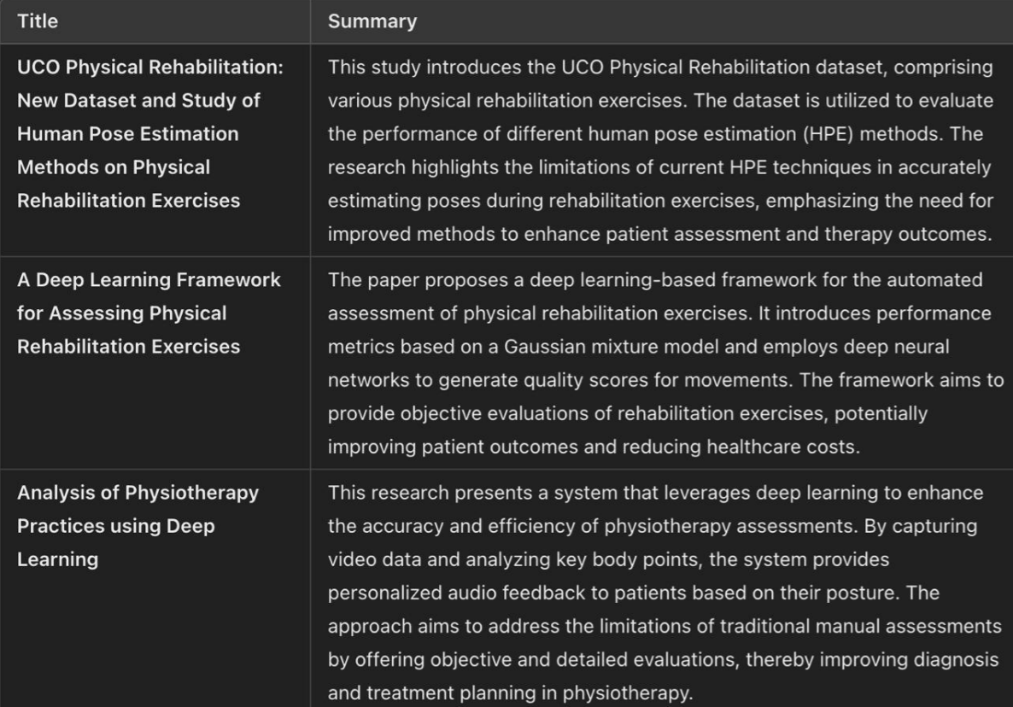
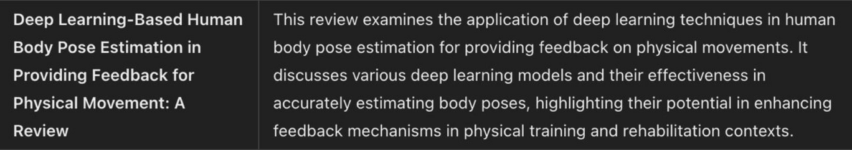
Summary in Tabular Form

Slide 5
Research Gaps
Objectives
This project aims to address these challenges by:
Develop a deep learning-based system that integrates video-based pose estimation with sensor-based activity recognition for precise motion analysis.
Train models using publicly available datasets, such as Human Activity Recognition (HAR) and PoseTrack, to accurately detect improper postures.
Design a real-time feedback mechanism to guide patients during physical therapy exercises.
Create a lightweight system optimized for affordability and accessibility, especially in remote or underserved areas.
Despite advancements in deep learning for motion analysis, several challenges remain:
Limited accessibility to affordable remote physiotherapy solutions.
Inaccurate posture detection due to variations in lighting, clothing, and patient diversity.
Lack of integration between video-based pose estimation and sensor data for comprehensive motion tracking.
High computational requirements, making real-time deployment difficult on consumer-grade devices.
Insufficient datasets that capture diverse rehabilitation scenarios.
Limited real-world validation, requiring user-friendly interfaces for physiotherapists and patients.

Slide 6
Methodology
Flow chart
Data Collection
Data Preprocessing
Model Training Optimization
and Evaluation
Correct or incorrectness of the Exercise
Real-Time Feedback Mechanism

Slide 7
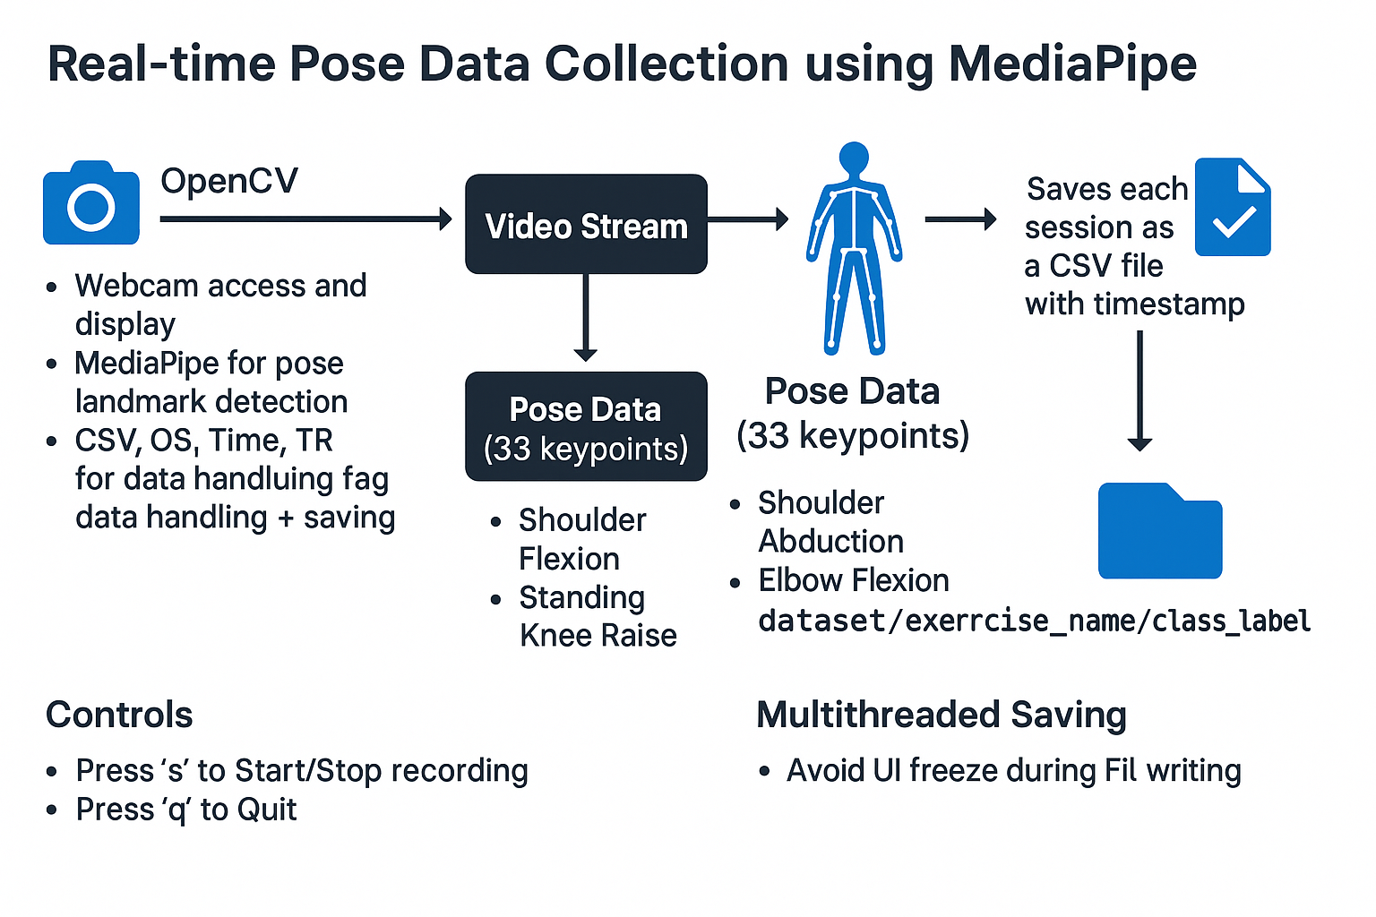
Methodology

Slide 8
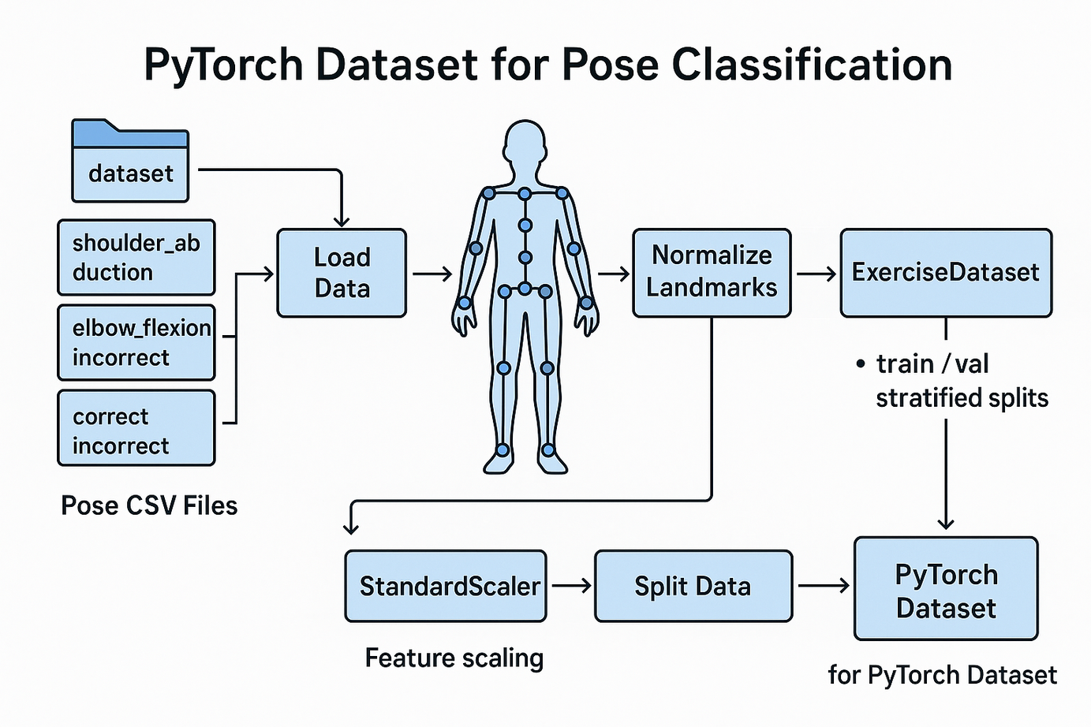
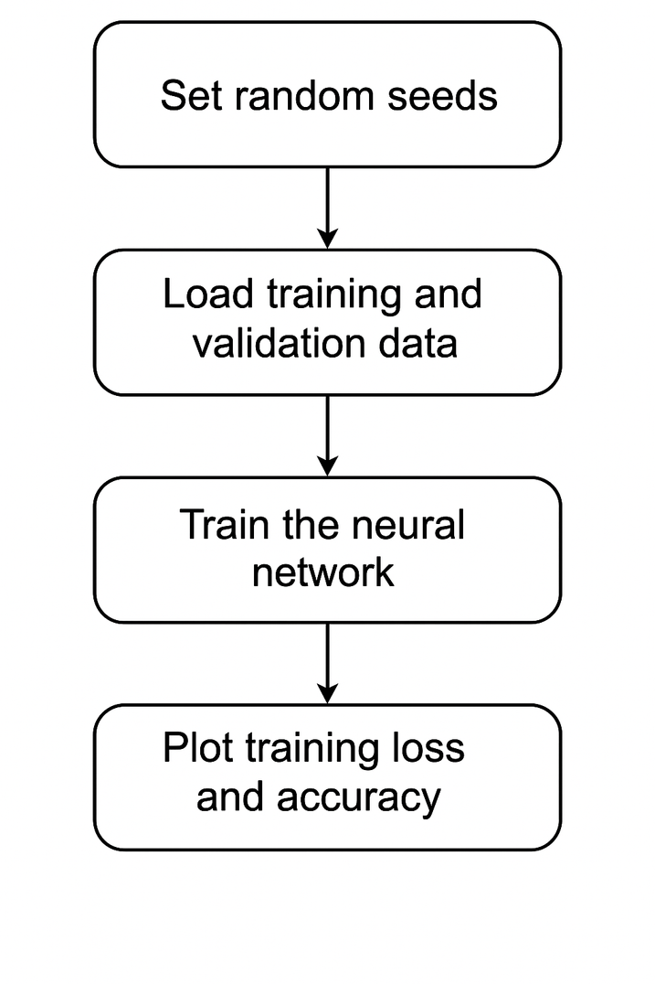
Methodology

Slide 9
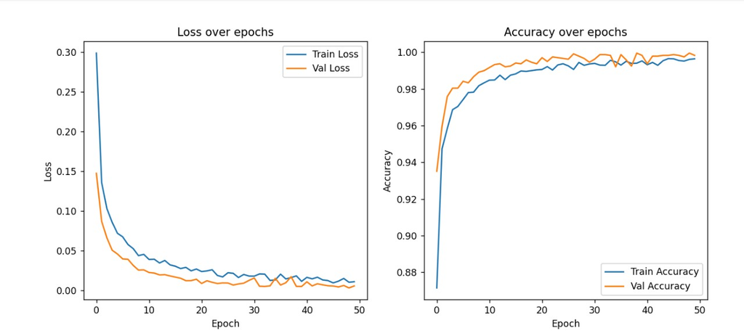
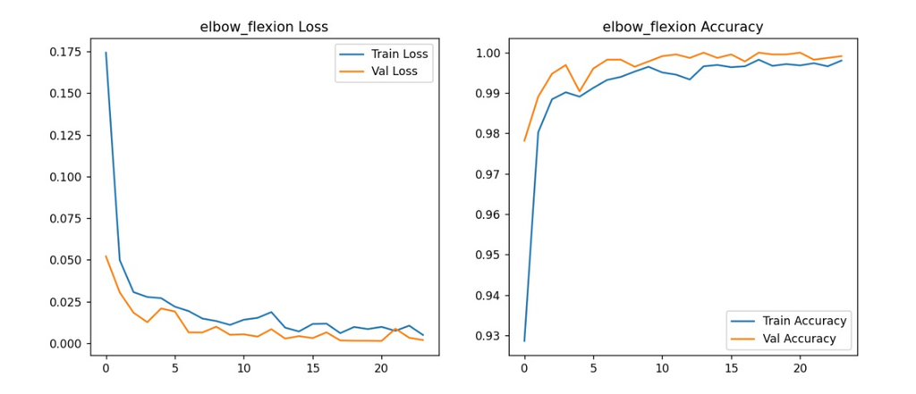
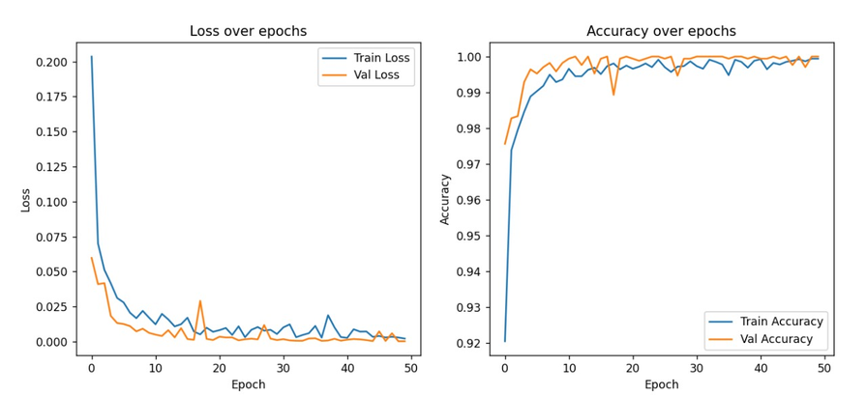
Loss & Accuracy over Epoch
Shoulder Abduction
Elbow Flexion
Standing Knee Raise

Slide 10
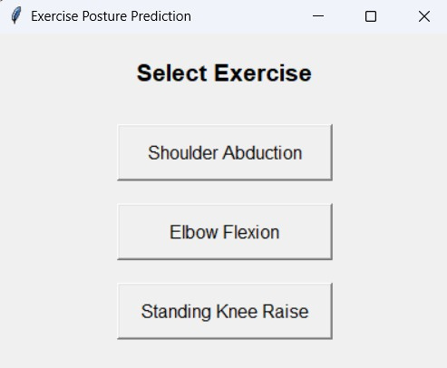
GUI

Slide 11
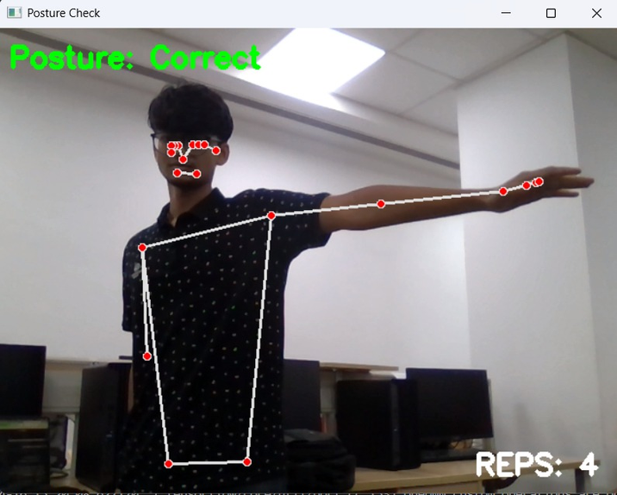
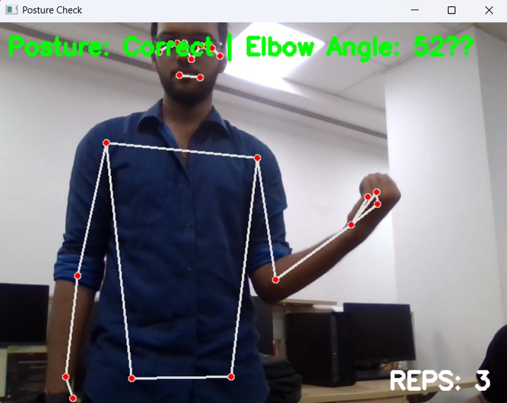
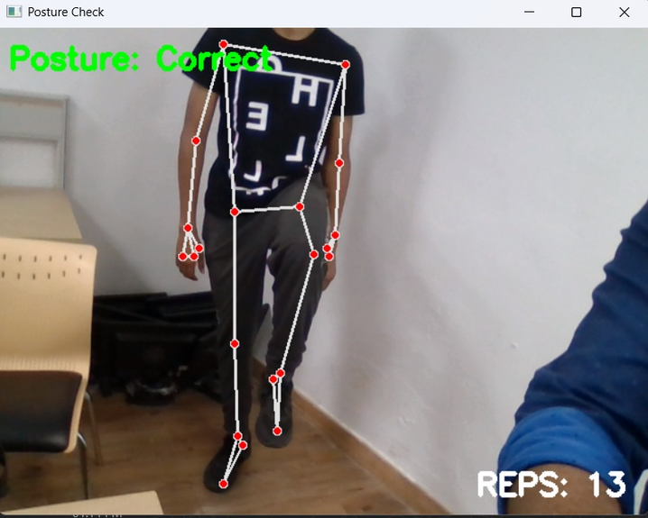
GUI
Shoulder Abduction
Elbow Flexion
Standing Knee Raise

Slide 12
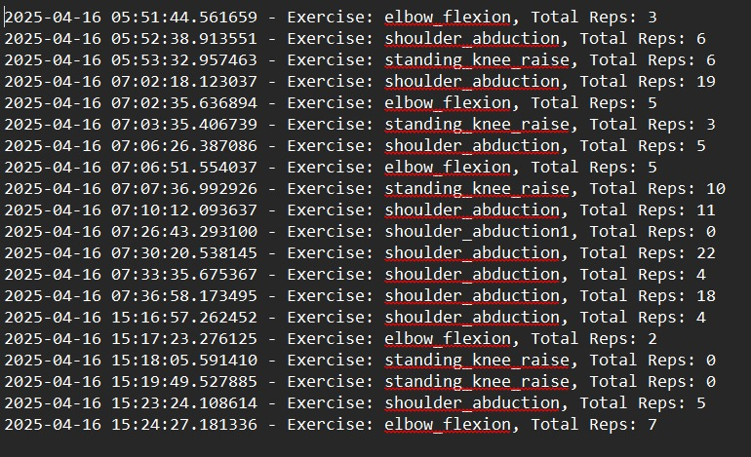
Storing Total Reps per day
For keeping a track of daily reps so that one can see his improvement each day

Slide 13
References
[1] R. Munoz-Salinas et al., ”UCO Physical Rehabilitation: New Dataset and ˜ Study of Human Pose Estimation Methods for Physical Rehabilitation,” Sensors, Oct. 2023.
[2] A. Vakanski, J. M. Ferguson, and S. Lee, ”A Deep Learning Framework for Assessing Physical Rehabilitation Exercises,” IEEE Trans. Neural Syst. Rehabil. Eng., Jan. 2020.
[3] S. B. Kulkarni, A. Kuppelur, A. Shetty, S. Bidarakatti, and T. Sangresakoppa, ”Analysis of Physiotherapy Practices using Deep Learning,” Int. J. Res. Appl. Sci. Eng. Technol., Apr. 2024.
[4] Wang et al., ”How Deep Neural Networks Understand Motion? Toward Understanding Motion Recognition by Neural Networks,” Intell. Comput., vol. 2, Feb. 2023.
[5] H. Ben-Younes, R. Cadene, M. Cord, and N. Thome, ”Deep LearningBased Human Body Pose Estimation in Providing Feedback for Physical Movement: A Review,” Heliyon

Slide 14
Thank you!

